Slide 1
SOFTWARE ENGINEERING
SWE-211
3+0 (Theory Credit Hour = 3, Lab Credit Hours = 0)
BS-CS-III

Slide 2
Outline
Introduction
Class rules
Marks distribution
Grading policy
Course portal
Course learning outcomes
Basics

Slide 3
Class Rules [1/2]
Be punctual
Late comers are not allowed
85% attendance
Be attentive
You pay to listen
I get paid to speak
Be prompt
Be always ready to learn
Class participation is important
Surprised quizzes

Slide 4
Class Rules [2/2]
Be polite
Be a soft-spoken person
Do not laugh on fellow’s questions
Be honest
Do your work by yourself
Do properly credit other’s work
Cheating is an academic offense (zero marks)
Do not waste others’ time
Be responsible
Switch off your cell phone
Penalty: treat for the whole class

Slide 5
Grading Distribution
S.No: | Assessment Criteria | Percentage?
1 | Midterm Exam | 30%
2 | Sessional Presentation = 4% SRS = 4 % Project Charter = 4% Case Study = 4% Active Class Participation = 2 % Online Software Tests = 2% | 20%
3 | Final EXAM | 50%

Slide 6
Grading Policy
No best quiz/assignment
No make up (even for sessional exams)
Regular assignments
Strict submission deadlines
Zero marks for the copied quizzes/assignments

Slide 7
SOFTWARE
Software is a set of instructions, data or programs used to operate computers and execute specific tasks. Opposite of hardware, which describes the physical aspects of a computer, software is a generic term used to refer to applications, scripts and programs that run on a device.
Computer software, or simply software, is a collection of data or computer instructions that tell the computer how to work. This is in contrast to physical hardware, from which the system is built and actually performs the work.

Slide 8
Software engineering
The economies of ALL developed nations are dependent on software
More and more systems are software controlled
Software engineering is concerned with theories, methods and tools for professional software development
Software engineering expenditure represents a significant fraction of GNP in all developed countries

Slide 9
Software costs
Software costs often dominate system costs. The costs of software on a PC are often greater than the hardware cost
Software costs more to maintain than it does to develop. For systems with a long life, maintenance costs may be several times development costs
Software engineering is concerned with cost-effective software development

Slide 10
FAQs about software engineering
What is software?
What is software engineering?
What is the difference between software engineering and computer science?
What is the difference between software engineering and system engineering?
What is a software process?
What is a software process model?

Slide 11
FAQs about software engineering
What are the costs of software engineering?
What are software engineering methods?
What is CASE (Computer-Aided Software Engineering)
What are the attributes of good software?
What are the key challenges facing software engineering?

Slide 12
What is software?
Computer programs and associated documentation
Software products may be developed for a particular customer or may be developed for a general market
Software products may be
Generic - developed to be sold to a range of different customers
Bespoke (custom) - developed for a single customer according to their specification

Slide 13
What is software engineering?
Software engineering is an engineering discipline which is concerned with all aspects of software production
Software engineers should adopt a systematic and organised approach to their work and use appropriate tools and techniques depending on the problem to be solved, the development constraints and the resources available

Slide 14
What is the difference between software engineering and computer science?
Computer science is concerned with theory and fundamentals; software engineering is concerned with the practicalities of developing and delivering useful software
Computer science theories are currently insufficient to act as a complete underpinning for software engineering

Slide 15
What is the difference between software engineering and system engineering?
System engineering is concerned with all aspects of computer-based systems development including hardware, software and process engineering. Software engineering is part of this process
System engineers are involved in system specification, architectural design, integration and deployment

Slide 16
What is a software process?
A set of activities whose goal is the development or evolution of software
Generic activities in all software processes are:
Specification - what the system should do and its development constraints
Development - production of the software system
Validation - checking that the software is what the customer wants
Evolution - changing the software in response to changing demands

Slide 17
What is a software process model?
A simplified representation of a software process, presented from a specific perspective
Examples of process perspectives are
Workflow perspective - sequence of activities
Data-flow perspective - information flow
Role/action perspective - who does what
Generic process models
Waterfall
Evolutionary development
Formal transformation
Integration from reusable components

Slide 18
What are the costs of software engineering?
Roughly 60% of costs are development costs, 40% are testing costs. For custom software, evolution costs often exceed development costs
Costs vary depending on the type of system being developed and the requirements of system attributes such as performance and system reliability
Distribution of costs depends on the development model that is used

Slide 19
What are software engineering methods?
Structured approaches to software development which include system models, notations, rules, design advice and process guidance
Model descriptions
Descriptions of graphical models which should be produced
Rules
Constraints applied to system models
Recommendations
Advice on good design practice
Process guidance
What activities to follow

Slide 20
What is CASE (Computer-Aided Software Engineering)
Software systems which are intended to provide automated support for software process activities. CASE systems are often used for method support
Upper-Case
Tools to support the early process activities of requirements and design
Lower-Case
Tools to support later activities such as programming, debugging and testing

Slide 21
What are the attributes of good software?
The software should deliver the required functionality and performance to the user and should be maintainable, dependable and usable
Maintainability
Software must evolve to meet changing needs
Dependability
Software must be trustworthy
Efficiency
Software should not make wasteful use of system resources
Usability
Software must be usable by the users for which it was designed

Slide 22
What are the key challenges facing software engineering?
Coping with legacy systems, coping with increasing diversity and coping with demands for reduced delivery times
Legacy systems
Old, valuable systems must be maintained and updated
Heterogeneity
Systems are distributed and include a mix of hardware and software
Delivery
There is increasing pressure for faster delivery of software

Slide 23
Software engineering diversity
There are many different types of software system that their is no universal set of software techniques that is applicable to all of these.
The software engineering methods and tools used depend on the type of application being developed, the requirements of the customer and the background of the development team.

Slide 24
Application types
Stand-alone applications
These are application systems that run on a local computer, such as a PC. They include all necessary functionality and do not need to be connected to a network.
Interactive transaction-based applications
Applications that execute on a remote computer and are accessed by users from their own PCs or terminals. These include web applications such as e-commerce applications.
Embedded control systems
These are software control systems that control and manage hardware devices. Numerically, there are probably more embedded systems than any other type of system.

Slide 25
Application types
Batch processing systems
These are business systems that are designed to process data in large batches. They process large numbers of individual inputs to create corresponding outputs.
Like Dairy Products , Manufacturing (like: packing of products)
Entertainment systems
These are systems that are primarily for personal use and which are intended to entertain the user.
Systems for modeling and simulation
These are systems that are developed by scientists and engineers to model physical processes or situations, which include many, separate, interacting objects.

Slide 26
Application types
Data collection systems
These are systems that collect data from their environment using a set of sensors and send that data to other systems for processing. Like Exam, Survey.
Systems of systems
These are systems that are composed of a number of other software systems. Like Energy - smart grid, smart houses, and integrated production/consumption,

Slide 27
Software engineering fundamentals
Some fundamental principles apply to all types of software system, irrespective of the development techniques used:
Systems should be developed using a managed and understood development process. Of course, different processes are used for different types of software.
Dependability and performance are important for all types of system.
Understanding and managing the software specification and
requirements (what the software should do) are important.
Where appropriate, you should reuse software that has already been developed rather than write new software.

Slide 28
Internet software engineering
The Web is now a platform for running application and organizations are increasingly developing web-based systems rather than local systems.
Web services allow application functionality to be accessed over the web.
Cloud computing is an approach to the provision of computer services where applications run remotely on the ‘cloud’.
Users do not buy software buy pay according to use.

Slide 29
Web-based software engineering
Web-based systems are complex distributed systems but the fundamental principles of software engineering discussed previously are as applicable to them as they are to any other types of system.
The fundamental ideas of software engineering apply to web-based software in the same way that they apply to other types of software system.

Slide 30
Web software engineering
Software reuse
Software reuse is the dominant approach for constructing web- based systems. When building these systems, you think about how you can assemble them from pre-existing software components and systems.
Incremental and agile development
Web-based systems should be developed and delivered incrementally. It is now generally recognized that it is impractical to specify all the requirements for such systems in advance.

Slide 31
Web software engineering
Service-oriented systems
Software may be implemented using service-oriented software engineering, where the software components are stand-alone web services.
Rich interfaces
Interface development technologies such as AJAX and HTML5 have emerged that support the creation of rich interfaces within a web browser.

Slide 32
Software Engineering Ethics
Software engineering involves wider responsibilities than
simply the application of technical skills.
Software engineers must behave in an honest and ethically responsible way if they are to be respected as professionals.
Ethical behavior is more than simply upholding the law but involves following a set of principles that are morally correct.

Slide 33
Professional and ethical responsibility
Software engineering involves wider responsibilities than simply the application of technical skills
Software engineers must behave in an honest and ethically responsible way if they are to be respected as professionals
Ethical behaviour is more than simply upholding the law.

Slide 34
Issues of professional responsibility
Confidentiality
Engineers should normally respect the confidentiality of their employers or clients irrespective of whether or not a formal confidentiality agreement has been signed.
Competence
Engineers should not misrepresent their level of competence. They should not knowingly accept work which is outwith their competence.

Slide 35
Issues of professional responsibility
Intellectual property rights
Engineers should be aware of local laws governing the use of intellectual property such as patents, copyright, etc. They should be careful to ensure that the intellectual property of employers and clients is protected.
Computer misuse
Software engineers should not use their technical skills to misuse other people’s computers. Computer misuse ranges from relatively trivial (game playing on an employer’s machine, say) to extremely serious (dissemination of viruses).

Slide 36
Rationale for the code of ethics
Computers have a central and growing role in commerce, industry, government, medicine, education, entertainment and society at large. Software engineers are those who contribute by direct participation or by teaching, to the analysis, specification, design, development, certification, maintenance and testing of software systems.
Because of their roles in developing software systems, software engineers have significant opportunities to do good or cause harm, to enable others to do good or cause harm, or to influence others to do good or cause harm. To ensure, as much as possible, that their efforts will be used for good, software engineers must commit themselves to making software engineering a beneficial and respected profession.

Slide 37
ACM/IEEE Code of Ethics
The professional societies in the US have cooperated to produce a code of ethical practice.
Members of these organisations sign up to the code of practice when they join.
The Code contains eight Principles related to the behaviour of and decisions made by professional software engineers, including practitioners, educators, managers, supervisors and policy makers, as well as trainees and students of the profession.

Slide 38
Code of ethics - preamble
Preamble
The short version of the code summarizes aspirations at a high level of the abstraction; the clauses that are included in the full version give examples and details of how these aspirations change the way we act as software engineering professionals. Without the aspirations, the details can become legalistic and tedious; without the details, the aspirations can become high sounding but empty; together, the aspirations and the details form a cohesive code.
Software engineers shall commit themselves to making the analysis, specification, design, development, testing and maintenance of software a beneficial and respected profession. In accordance with their commitment to the health, safety and welfare of the public, software engineers shall adhere to the following Eight Principles:

Slide 39
Code of ethics - principles
1. PUBLIC
Software engineers shall act consistently with the public interest.
2. CLIENT AND EMPLOYER
Software engineers shall act in a manner that is in the best interests of their client and employer consistent with the public interest.
3. PRODUCT
Software engineers shall ensure that their products and related modifications meet the highest professional standards possible.

Slide 40
Code of ethics - principles
JUDGMENT
Software engineers shall maintain integrity and independence in their professional judgment.
5. MANAGEMENT
Software engineering managers and leaders shall subscribe to and promote an ethical approach to the management of software development and maintenance.
6. PROFESSION
Software engineers shall advance the integrity and reputation of the profession consistent with the public interest.

Slide 41
Code of ethics - principles
7. COLLEAGUES
Software engineers shall be fair to and supportive of their colleagues.
8. SELF
Software engineers shall participate in lifelong learning regarding the practice of their profession and shall promote an ethical approach to the practice of the profession.

Slide 42
Ethical dilemmas
Disagreement in principle with the policies of senior management
Your employer acts in an unethical way and releases a safety-critical system without finishing the testing of the system
Participation in the development of military weapons systems or nuclear systems

Slide 43
Software Engineering CASE STUDIES
An Insulin pump control system
A patient Information System for Mental Health Care
A wilderness weather station

Slide 44
Software project failure
Increasing system complexity
As new software engineering techniques help us to build larger, more complex systems, the demands change. Systems have to be built and delivered more quickly; larger, even more complex systems are required; systems have to have new capabilities that were previously thought to be impossible.
Failure to use software engineering methods
It is fairly easy to write computer programs without using software engineering methods and techniques. Many companies have drifted into software development as their products and services have evolved. They do not use software engineering methods in their everyday work. Consequently, their software is often more expensive and less reliable than it should be.

Slide 45
Frequently asked questions about software engineering
Question | Answer
What is software? | Computer programs and associated documentation. Software products may be developed for a particular customer or may be developed for a general market.
What are the attributes of good software? | Good software should deliver the required functionality and performance to the user and should be maintainable, dependable and usable.
What is software engineering? | Software engineering is an engineering discipline that is concerned with all aspects of software production.
What are the fundamental software engineering activities? | Software specification, software development, software validation and software evolution.
What is the difference between software engineering and computer science? | Computer science focuses on theory and fundamentals; software engineering is concerned with the practicalities of developing and delivering useful software.
What is the difference between software engineering and system engineering? | System engineering is concerned with all aspects of computer-based systems development including hardware, software and process engineering. Software engineering is part of this more general process.

Slide 46
Frequently asked questions about software engineering
Question | Answer
What are the key challenges facing software engineering? | Coping with increasing diversity, demands for reduced delivery times and developing trustworthy software.
What are the costs of software engineering? | Roughly 60% of software costs are development costs, 40% are testing costs. For custom software, evolution costs often exceed development costs.
What are the best software engineering techniques and methods? | While all software projects have to be professionally managed and developed, different techniques are appropriate for different types of system. For example, games should always be developed using a series of prototypes whereas safety critical control systems require a complete and analyzable specification to be developed. You can’t, therefore, say that one method is better than another.
What differences has the web made to software engineering? | The web has led to the availability of software services and the possibility of developing highly distributed service- based systems. Web-based systems development has led to important advances in programming languages and software reuse.

Slide 47
Software products
Generic products
Stand-alone systems that are marketed and sold to any customer who wishes to buy them.
Examples – PC software such as graphics programs, project management tools; CAD software; software for specific markets such as appointments systems for dentists.
Customized products
Software that is commissioned by a specific customer to meet
their own needs.
Examples – embedded control systems, air traffic control software, traffic monitoring systems.

Slide 48
Product specification
Generic products
The specification of what the software should do is owned by the software developer and decisions on software change are made by the developer.
Customized products
The specification of what the software should do is owned by the customer for the software and they make decisions on software changes that are required.

Slide 49
Essential attributes of good software
Product characteristic Description
Maintainability | Software should be written in such a way so that it can evolve to meet the changing needs of customers. This is a critical attribute because software change is an inevitable requirement of a changing business environment.
Dependability and security | Software dependability includes a range of characteristics including reliability, security and safety. Dependable software should not cause physical or economic damage in the event of system failure. Malicious users should not be able to access or damage the system.
Efficiency | Software should not make wasteful use of system resources such as memory and processor cycles. Efficiency therefore includes responsiveness, processing time, memory utilisation, etc.
Acceptability | Software must be acceptable to the type of users for which it is designed. This means that it must be understandable, usable and compatible with other systems that they use.

Slide 50
Case studies Solution
A personal insulin pump
An embedded system in an insulin pump used by diabetics to maintain blood glucose control.
A mental health case patient management system
Mentcare. A system used to maintain records of people receiving
care for mental health problems.
A wilderness weather station
A data collection system that collects data about weather
conditions in remote areas.
iLearn: a digital learning environment
A system to support learning in schools

Slide 51
Insulin pump control system
Collects data from a blood sugar sensor and calculates
the amount of insulin required to be injected.
Calculation based on the rate of change of blood sugar levels.
Sends signals to a micro-pump to deliver the correct dose of insulin.
Safety-critical system as low blood sugars can lead to brain malfunctioning, coma and death; high-blood sugar levels have long-term consequences such as eye and kidney damage.

Slide 52
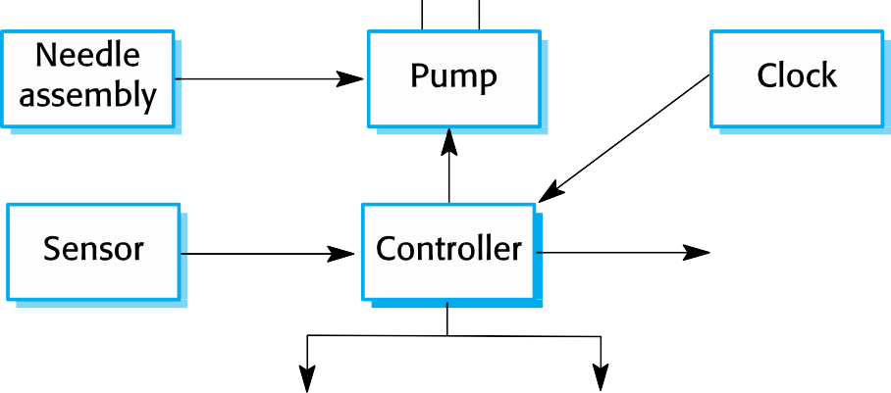

Insulin pump hardware architecture

Slide 53
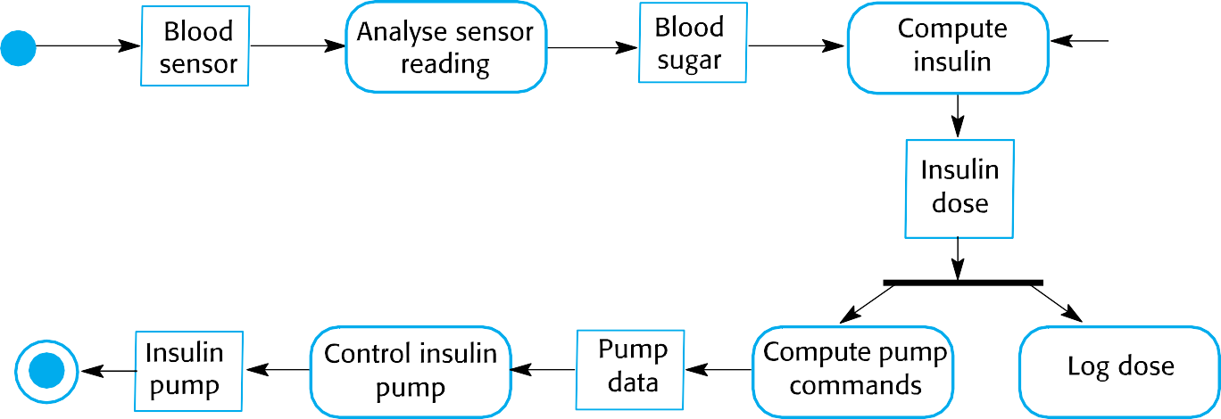

Activity model of the insulin pump

Slide 54
Essential high-level requirements
The system shall be available to deliver insulin when
required.
The system shall perform reliably and deliver the correct amount of insulin to counteract the current level of blood sugar.
The system must therefore be designed and implemented to ensure that the system always meets these requirements.

